Slide 1
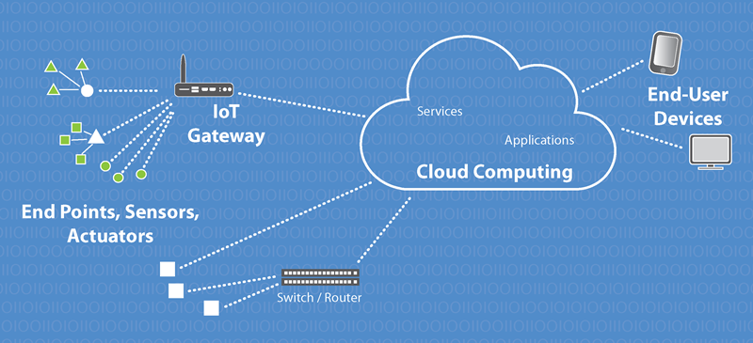
SMART CONNECTED SIGN BOARD FOR IMPROVED ROAD SAFETY
Team Stark

Slide 2
INTRODUCTION
The smart connected sign board is a digital, IoT based sign board which updates the feature of the road/route/area.
It may be a prediction of the obstruction present, weather or even the temperature.
The main objective of the project is to improve the safety of the ones driving the vehicles , etc.

Slide 3
APPLICATION
The project proposes a system which has digital sign boards on which the signs can be changed dynamically.
Displays speed limit-------- tells the user to slow down
Displays on diversions , Alerts of accident prone area.
Shows information on sign boards.

Slide 4
INSTALLATION
In a car
Mobile application
Roads (screen,update---- the difference between the static sign boards being more accurate and more informative)

Slide 5
COMPONENTS REQUIRED
Hardware
Softwares
NodeMCU
Push Button
OLED display
Basic Shield
Arduino IDE
HTML, Javascript,

Slide 6
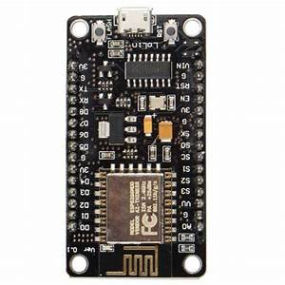
NodeMCU
NodeMCU is an open source IoT platform. It includes firmware which runs on the ESP8266 Wi-Fi SoC. It uses Lua Script Language.

Slide 7
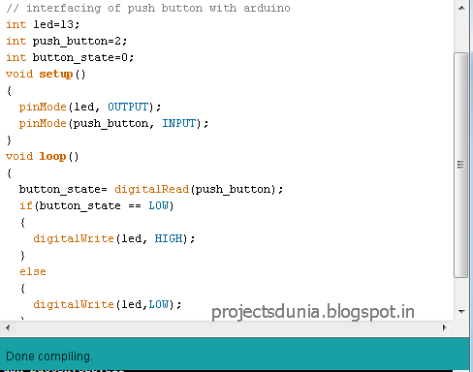
ARDUINO
The code is written inside the Arduino IDE, according to the logic.

Slide 8
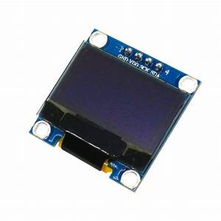
OLED
The info is displayed in the OLED as per the conditioned code.

Slide 9
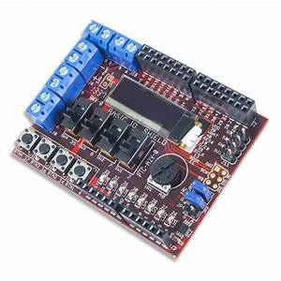
Basic shield
Provide the basic I/O interface in the form of buttons , switches, etc

Slide 10
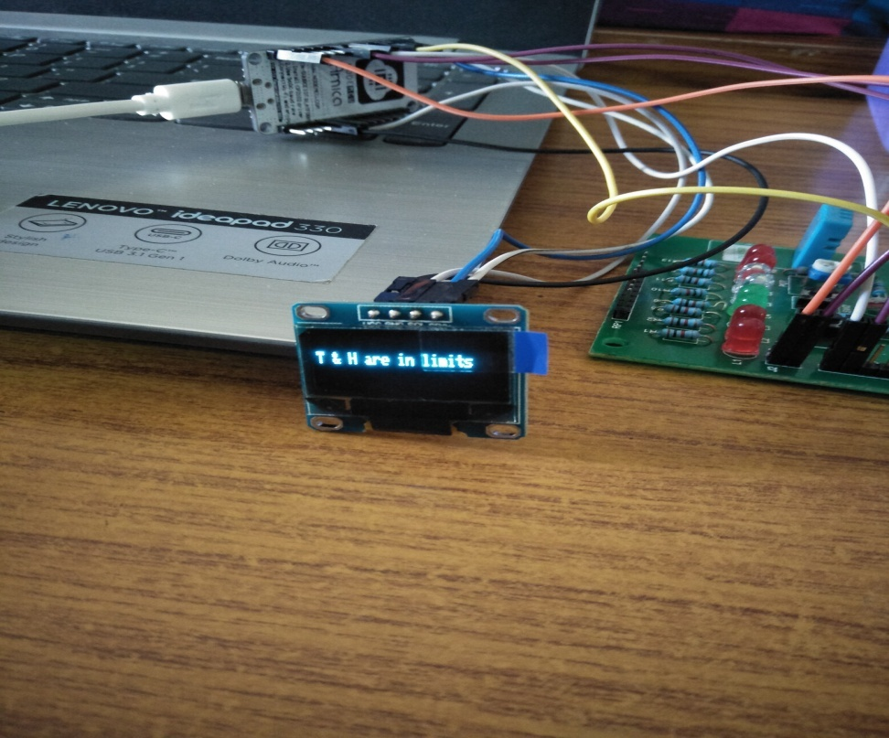
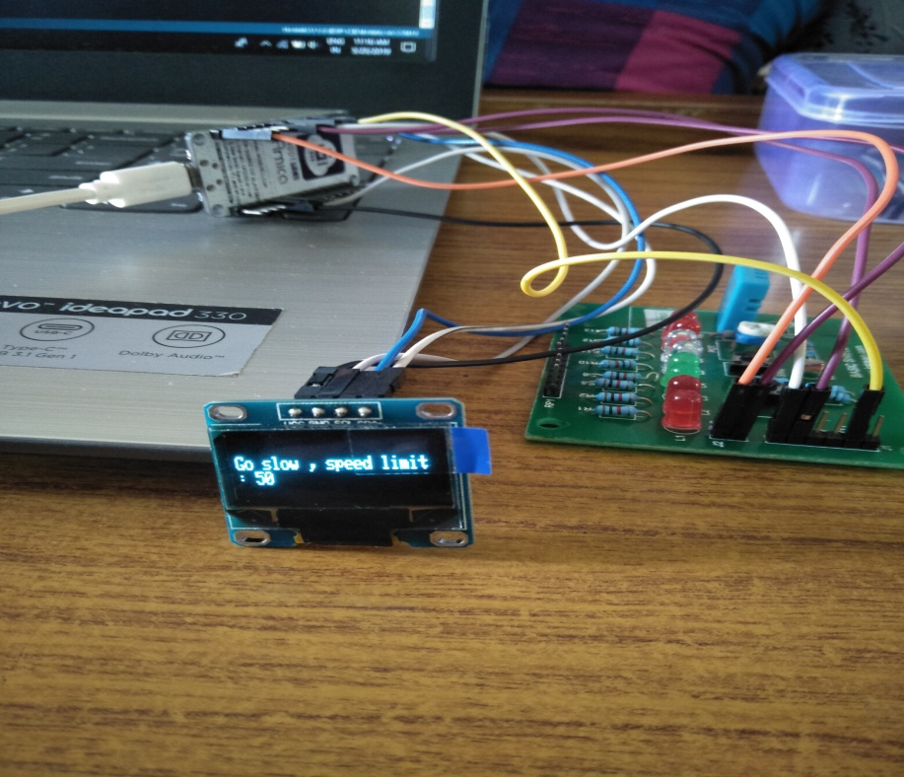
OUTPUT

Slide 11
CONCLUSION
If maybe, just maybe this system can be carried out exactly like the description, it would be very helpful to reduce accident rates.
If this application can be made big, there is no wonder that it will benefit all of us.
Not only the car drivers but also anyone who wants to know the geographical condition of the area

Slide 12
Thank You

